Slide 1
L.O: To describe physical changes that occur in puberty and know ways to manage emotional and relationship changes.
We will be thinking about:
Ways of managing physical changes during puberty, including how and why it is important to keep clean.
How emotions and relationships may change during puberty.
How and when to get help and support in relation to puberty.

Slide 2
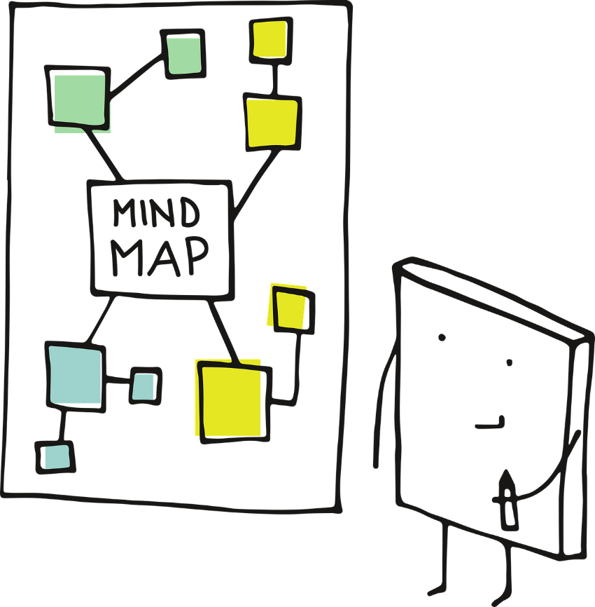
Growing and changing
What’s our starting point?
Imagine a young person about your age or a little older. They are going through puberty.
What might they find difficult about puberty?
What might they do to manage these challenges?
Draw a mind map and try to include as many answers to the two questions above as you can.

Slide 3
What body parts do you think someone going through puberty might need to pay special attention to while keeping clean?
Draw a person and write your answers around them, or discuss with a partner.
Skin and spots
Skin also gets oilier during puberty. Sometimes this oil traps dirt or germs. While they can be upsetting and embarrassing, they are a normal part of puberty. Everyone will get them at some point in their life, it doesn’t mean they have poor hygiene!
Hair
During puberty hair can get oilier. Washing hair with warm water and a small amount of shampoo can help to control oil.
Washing genitals
The vulva: Washing the outside part of the vulva with an unperfumed soap every day can help to keep it clean. The inside of the vagina can clean itself and this does not need washing, and cleaning inside can cause irritation.
The penis: Gently washing the penis with warm water and soap each day keeps it clean. If the penis has a foreskin, this should be gently pulled back and washed underneath. This prevents the build up of too much smegma, a cheesy-looking substance that can start to smell and build up bacteria.
Sweat and body odour
During puberty sweat glands become more active than before and sweat can smell stronger.
Showering or bathing everyday using warm water and a mild soap or shower gel can help keep the smell and bacteria under control. Wearing clean clothing can also help to keep clean.
Deodorants cover up the smell of body odour and anti-perspirants reduce sweating.

Slide 4
How often should a person do each of the activities below?
Write each activity under one of the time headings, or discuss with a partner. Click each of the headings to reveal answers.
Activities
Washing hair
Brushing hair
Brushing teeth
Showering or bathing
Putting on deodorant
Changing underwear
Washing PE kit
Wash day-to-day clothes
Every day
Every day: Brush hair, brush teeth twice in a day, put on deodorant and change underwear. Shower if the person exercised that day.
A few times a week
A few times a week:
Shower or have a bath, wash hair (may be more or less depending on how oily a person’s hair is) and wash clothes.
Once a week
Once a week:
Wash PE kit (or more often if you do PE on more than one day) or outerwear such as school jumpers.
Notes:
Every day
Brush hair, brush teeth twice in a day, put on deodorant and change underwear. Shower if the person exercised that day.
A few times a week
Shower or have a bath, wash hair (may be more or less depending on how oily a person’s hair is) and wash clothes.
Once a week
Wash PE kit (or more often if you do PE on more than one day) or outerwear such as school jumpers.

Slide 5
Feelings and emotions
Hormones, which are special chemicals in the body, change the body’s physical appearance. They can also affect how people’s emotions.
On a piece of paper, write out different emotions or feelings someone might have during puberty.
Once you have done this, cut these out so that each feeling is on a separate piece of paper.
Happy
Sad
Fed up

Slide 6
An emotional rollercoaster
On a new piece of paper, draw a wavy line like the one below.
Sometimes feelings can change quickly during puberty, one minute a person can feel really happy (or up) and the next they can feel really sad (or low.)
Arrange the emotions and feelings you wrote out earlier on the line. Which feelings are high up? Which feelings are low down?
Are there any somewhere in the middle?
How could someone manage the low feelings to help themselves feel better?
Happy
Fed up
Sad

Slide 7
Sometimes a person might need help and support to manage their feelings during puberty.
Which of the options below do you think would be most helpful to manage each of the situations?
Options:
Situations:
A
Talking to a friend
Talking to a family member
Visiting childline for advice, and using services such as ‘Ask Sam’ on their website
Reading a book about it
Doing nothing
Something else (if you have any other ideas, discuss your partner)
Cathy keeps feeling really angry about little things. She shouted at her mum and now she’s upset.
B
Devan is worried about the changes that might happen to their body.
C
Lando is embarrassed about the spot that has appeared on her face. She’s worried everyone will notice and laugh at her.

Slide 8
Growing and changing.
Where are you now?
Look back at your mind map from the start of the lesson.
Can you add to or change anything that you have written about managing the challenges a person might experience during puberty?

Slide 9
Remember!
If you feel worried about puberty or what you have learned during this session, talking to an adult you trust is one of the best ways to find help.
If you want to talk to someone other than a parent:
ChildLine can help. See:
https://www.childline.org.uk/get-support/ or phone 0800 1111
Talk to a trusted adult at home
ChildLine: www.childline.org.uk
0800 1111

